Slide 1

Indexing

Slide 2
Last Week
What did we discuss?
File Organization
Fixed-length records file
Variable-length records file

Slide 3
Outline
Today’s Topics
Introduction to Indexing
Evaluation Factors for Indexing
Primary vs Secondary Indexing
Multi-level Indexing
B+ Tree Indexing

Slide 4


Let’s find a file in these cabinets

Slide 5
File structure
How to find a record in this file?
.
.
.
.
.

Slide 6
Basic Concepts
An index file consists of records (called index entries) of the form
Then the structure becomes
search-key
pointer
Data file
Index file

Slide 7
How do we evaluate the performance of an index?
Access time
Insertion time
Deletion time
Space overhead
Overhead
Index
Actual Data File

Slide 8
Index types
Index
Clustered /
Primary
Non-Clustered /
Secondary
Dense
Sparse

Slide 9
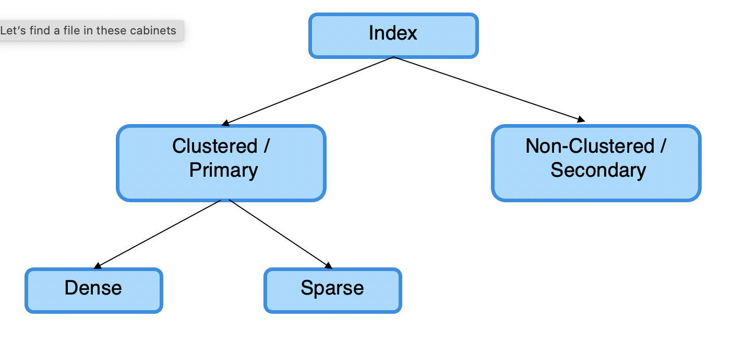
Clustered Index
Primary Index
Data file is sorted based on the search key
Can be Dense or Sparse
Dense
Each unique search key value in the data file has a corresponding index entry
Sparse
Several data records may have only one index key
There can be only one primary index per data file. Why?

Slide 10
Non-Clustered Index
Data file does not need to be sorted based on the search key
There can be more than one secondary indices per data file. Why?

Slide 11
Dense Index Files
Dense index — Index record appears for every search-key value in the file.
Ex: index on ID attribute of instructor relation

Slide 12
Dense Index Files (Cont.)
Dense index on dept_name, with instructor file sorted on dept_name dense-clustering index

Slide 13
Sparse Index Files
Sparse Index: contains index records for only some search-key values.
Applicable when records are sequentially ordered on search-key
To locate a record with search-key value K we:
Find index record with largest search-key value < K
Search file sequentially starting at the record to which the index record points

Slide 14
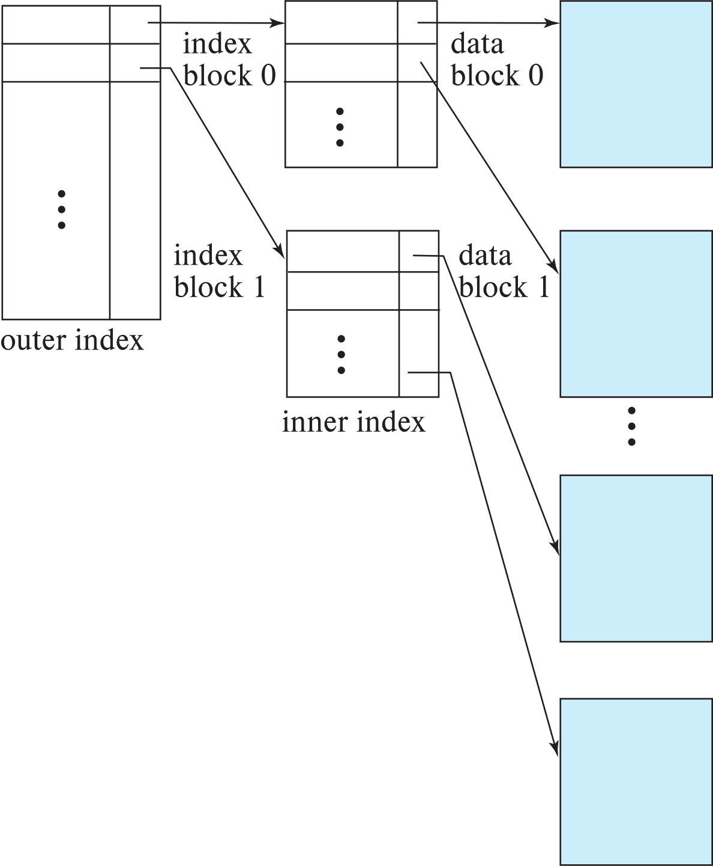
Sparse Index Files (Cont.)
Compared to dense indices:
Less space and less maintenance overhead for insertions and deletions.
Generally slower than dense index for locating records.
Good tradeoff:
for clustered index: sparse index with an index entry for every block in file, corresponding to least search-key value in the block.

Slide 15
Secondary Indices Example
Secondary index on salary field of instructor
Index record points to a bucket that contains pointers to all the actual records with that search-key value.
Secondary indices must be dense - Why?

Slide 16

Class Discussion
Discuss candidate fields (properties) for each category of indices (Primary and Secondary) using the Student data table in University database as an example.

Slide 17
Problems of creating a single index
For faster access, index must reside in main memory
If index does not fit in memory, access becomes expensive.
We need to read from disk, and it is expensive

Slide 18
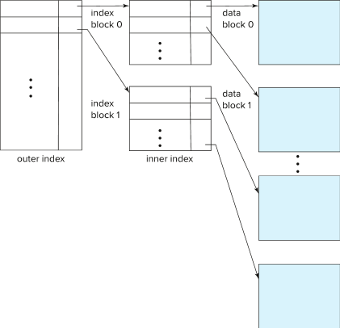
Multilevel Index (Cont.)
In memory
In Disk

Slide 19
Problems of indexed-sequential file
Performance degrades as file grows, since many overflow blocks get created.
Periodic reorganization of entire file is required.

Slide 20
B⁺-Tree Index Files
Solution for for shortcomings of indexed-sequential files
Advantage of B⁺-tree index files:
Automatically reorganizes itself with small, local, changes, in the face of insertions and deletions.
Reorganization of entire file is not required to maintain performance.

Slide 21
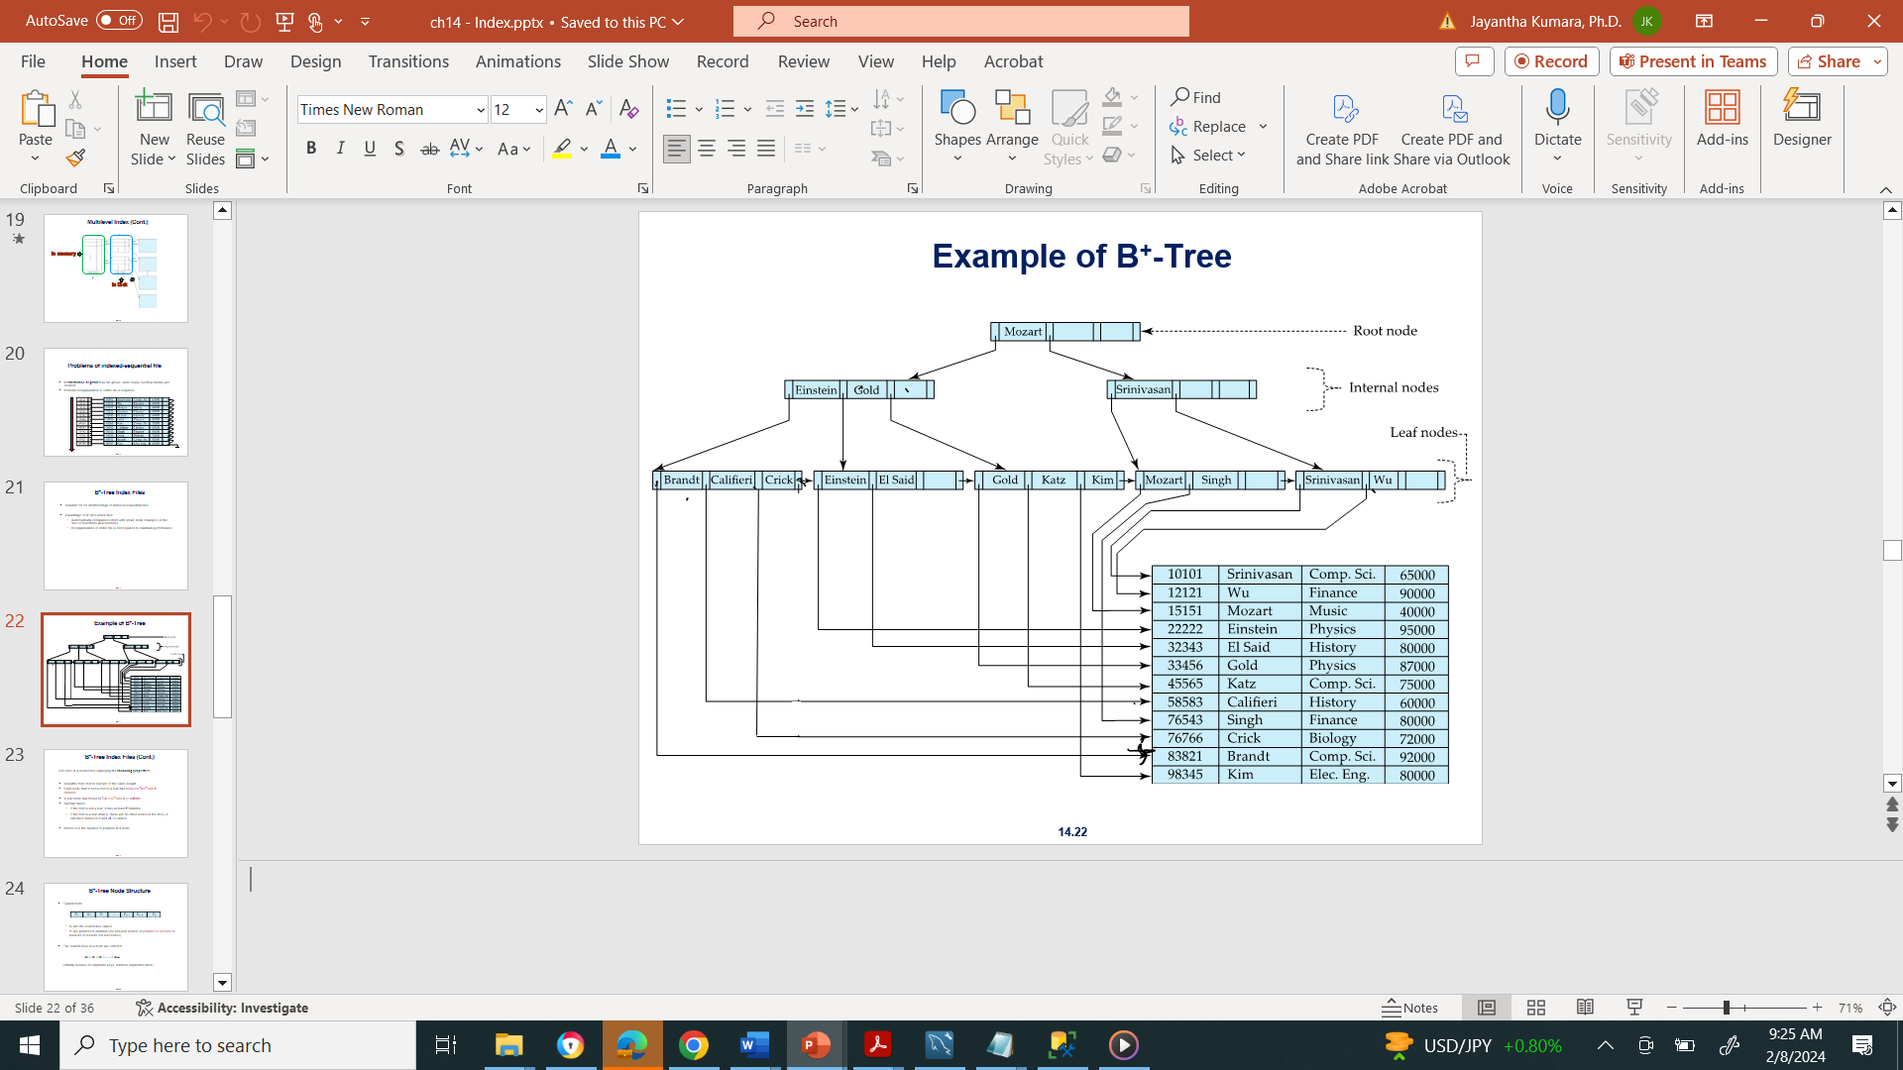
Example of B⁺-Tree
If there are K search-key values in the file, the tree height is no more than ⎡ log_{⎡n/2⎤}(K)⎤
With 1 million search key values and n = 100 at most log₅₀(1,000,000) = 4 nodes are accessed in a lookup traversal from root to leaf.

Slide 22
B⁺-Tree Index Files (Cont.)
A B⁺-tree is a rooted tree satisfying the following properties:
All paths from root to leaf are of the same length
Each node that is not a root or a leaf has between ⎡n/2⎤ and n children.
A leaf node has between ⎡(n–1)/2⎤ and n–1 values
Special cases:
If the root is not a leaf, it has at least 2 children.
If the root is a leaf (that is, there are no other nodes in the tree), it can have between 0 and (n–1) values.
Where n is the number of pointers in a node

Slide 23
B⁺-Tree Node Structure
Typical node
K_{i} are the search-key values
P_{i} are pointers to children (for non-leaf nodes) or pointers to records or buckets of records (for leaf nodes).
The search-keys in a node are ordered
K₁ < K₂ < K₃ < . . . < K_{n–1}
(Initially assume no duplicate keys, address duplicates later)

Slide 24
Leaf Nodes in B⁺-Trees
Properties of a leaf node:
For i = 1, 2, . . ., n–1, pointer P_{i} points to a file record with search-key value K_{i},
If L_{i}, L_{j} are leaf nodes and i < j, L_{i}’s search-key values are less than or equal to L_{j}’s search-key values
P_{n} points to next leaf node in search-key order

Slide 25
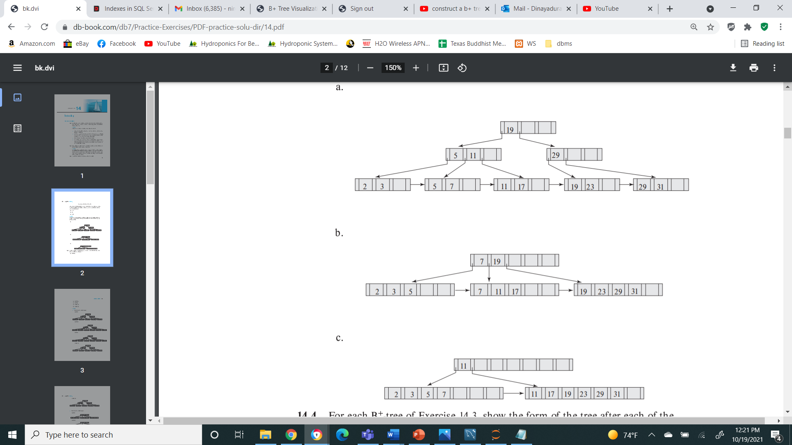
Non-Leaf Nodes in B⁺-Trees
Non leaf nodes form a multi-level sparse index on the leaf nodes. For a non-leaf node with n pointers:
All the search-keys in the subtree to which P₁ points are less than K₁
For 2 ≤ i ≤ n – 1, all the search-keys in the subtree to which P_{i} points have values greater than or equal to K_{i–1} and less than K_{i}
All the search-keys in the subtree to which P_{n} points have values greater than or equal to K_{n–1}

Slide 26
Example of B⁺-tree
B⁺-tree for instructor file (n = 6)
Leaf nodes must have between 3 and 5 values (⎡(n–1)/2⎤ and n –1, with n = 6).
Non-leaf nodes other than root must have between 3 and 6 children (⎡(n/2⎤ and n with n =6).
Root must have at least 2 children.

Slide 27
Updates on B⁺-Trees: Insertion (Cont.)
Splitting a leaf node:
take the n (search-key value, pointer) pairs (including the one being inserted) in sorted order. Place the first ⎡n/2⎤ in the original node, and the rest in a new node.
let the new node be p, and let k be the least key value in p. Insert (k,p) in the parent of the node being split.
If the parent is full, split it and propagate the split further up.
Splitting of nodes proceeds upwards till a node that is not full is found.
In the worst case the root node may be split increasing the height of the tree by 1.
Result of splitting node containing Brandt, Califieri and Crick on inserting Adams
Next step: insert entry with (Califieri, pointer-to-new-node) into the parent

Slide 28
B⁺-Tree Insertion
Affected nodes
B⁺-Tree before and after insertion of “Adams”

Slide 29
B⁺-Tree Insertion
B⁺-Tree before and after insertion of “Lamport”
Affected nodes
Affected nodes

Slide 30
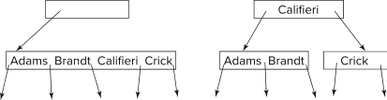
Insertion in B⁺-Trees (Cont.)
Splitting a non-leaf node: when inserting (k,p) into an already full internal node N
Copy N to an in-memory area M with space for n+1 pointers and n keys
Insert (k, p) into M
Copy P₁,K₁, …, K _{⎡n/2⎤-1},P _{⎡n/2⎤} from M back into node N
Copy P_{⎡n/2⎤+1},K _{⎡n/2⎤+1},…,K_{n},P_{n+1} from M into newly allocated node N'
Insert (K _{⎡n/2⎤},N') into parent N
Example
Read pseudocode in book!

Slide 31
Examples of B⁺-Tree Deletion
Before and after deleting “Srinivasan”
Affected nodes
Deleting “Srinivasan” causes merging of under-full leaves

Slide 32
Examples of B⁺-Tree Deletion (Cont.)
Before and after deleting “Singh” and “Wu”
Affected nodes
Leaf containing Singh and Wu became under full, and borrowed a value Kim from its left sibling
Search-key value in the parent changes as a result

Slide 33
Practice Homework
Insert the following set of numbers to a B+-Tree.
1,3,4,5,6,8,10,12,13,15,16,18,20,23,25,30, 32
The node span is 5 (n = 5)

Slide 34
Summary
Indexing is used to speed up the database operations
Index introduces an overhead and that does not out weight the advantages of having an index
Clustered and non-clustered indexing were discussed
B+ Tree is one of the techniques of generating an index for a data file

